Slide 1
PHYSIOLOGY LEC1
Dr. Hanaa Salman Kadhum
Department of Pathological Anylasis
Collage of science- University of Basrah

Slide 2
Introduction
Physiology, in simple terms, refers to the study of normal functioning of
the living structures. The human physiology is concerned with the way the
various systems of the human body function, and the way each
contributes to the functions of the body as a whole. In other words, the
human physiology is concerned with specific characteristics and
mechanisms of the human body that make it a living being, and the
mechanisms which help in adaptation and homeostasis, which are the
two fundamental features of life.
The general physiology envisages the general concepts and principles
that are basic to the functions of all the systems. As we know, the
fundamental unit of human body is a cell;, therefore, this section includes
a short review of fundamental aspect of the cell physiology. Before
studying the general biophysiological processes and the cell physiology,
it will be worthwhile to have a brief knowledge about the functional
organization, composition and internal environment of the human body.

Slide 3
Functional organization of the human body
The human body is actually a social order of about 100 trillion cells
organized into different functional structures, some of which are called
organs, some organs combinedly form a system. For convenience of
description, the human body can be considered to be functionally
organized into various systems.
1. Skin and its appendages
Skin is the outermost covering of the human body. Its appendages
include hairs, nails, sebaceous glands and sweat glands. In addition to
providing mechanical protection to the underlying tissues, the skin
performs following important functions:

Slide 4
It acts as a physical barrier against entry of micro-organisms and other substances.
It prevents loss of water from the body.
It is a very important sensory organ, containing receptors for touch and related sensations.
It plays an important role in regulating body temperature.

Slide 5
2. Skeletal system
The basic framework of the body is provided by a large number of bones
that collectively form the skeleton. At joints, the bones are united to each
other by fibrous bands called ligaments. In addition to the bones and
joints, the skeletal system also includes the cartilages present in the body.
3. Muscle system
Overlying and usually attached to the bones are various muscles.
Muscles are composed of many elongated cells called muscle fibres which
are able to contract and relax. Three distinct types of muscles can be
identified, and they are skeletal muscles, smooth muscles and cardiac
muscles.

Slide 6
4. Nervous system
The nervous system is made up, predominantly, of tissue that has the
special property of being able to conduct impulses rapidly from one part
of the body to another. The specialized cells that constitute the functional
units of the nervous system are called neurons. The nervous system may
be divided into: (i) the central nervous system, made up of brain and spinal
cord, and (ii) the peripheral nervous system, consisting of the peripheral
nerves and the ganglia associated with them. The nerves supplying the
body wall and limbs are often called cerebrospinal nerves. The nerves
supplying the viscera, along with the parts of the brain and spinal cord
related to them, constitute the autonomic nervous system. The autonomic
nervous system is subdivided into two major parts: the sympathetic and
the parasympathetic nervous system.

Slide 7
5. Cardiovascular system
The cardiovascular system consists of the heart and the blood vessels. The
blood vessels that take blood from the heart to various tissues are called
arteries. The smallest arteries are called arterioles. Arterioles open into a
network of capillaries that perfuse the tissues. Exchange of various
substances between the blood and the tissues take place through the
walls of capillaries. In some situations, capillaries are replaced by slightly
different vessels called sinusoids. Blood from capillaries (or from
sinusoids) is collected by small venules which join to form veins. The veins
return blood to the heart.

Slide 8
6. Respiratory system
The respiratory system consists of the lungs and the passages through
which air reaches them. The passages are nasal cavities, the pharynx, the
trachea, the bronchi and their intrapulmonary continuations
7. Digestive system
The digestive or the so-called alimentary system includes all those
structures that are concerned with eating, and with the digestion and
absorption of food. The system consists of an alimentary canal which
starts at the mouth and ends at the anus. The alimentary canal includes
the oral cavity, pharynx, oesophagus, stomach, small intestine and large
intestine. Other structures included in the digestive system are the liver,
the gall bladder and the pancreas.

Slide 9
8. Excretory system
Excretion is the removal of waste products of metabolism from the body.
Egestion (or defaecation) is the removal of undigested food from the gut
and is not regarded as excretion because the material taken into the gut
through the mouth is not made by the body itself. The organs forming
the excretory system are the kidney, the ureters, the bladder and the
urethra.
9. Reproductive system
Reproduction is the production of a new generation of individuals of the
same species. It involves the transmission of genetic material from one
generation to the next. The male reproductive organs are the testis, the
epididymis, the ductus deferens, and the seminal vesicles (which are
paired), and the prostate, the male urethra and the penis (which are
unpaired). The female reproductive organs are the right and left ovaries and
uterine tubes, the uterus, the vagina, the external genitalia and the
mammary glands.

Slide 10
10. Endocrine system
Endocrine tissue is made up essentially of cells that produce secretions
which are poured directly into blood. The secretions of the endocrine
cells are called hormones. Some organs are entirely endocrine in function.
They are referred to as endocrine glands (or ductless glands). Those
traditionally included under this heading are the hypophysis cerebral
(pituitary gland), the pineal gland, the thyroid gland, the parathyroid
glands, and the suprarenal (adrenal) glands. Groups of endocrine cells
may be present in the organs that have other functions. These include the
islets of Langerhans of pancreas, the interstitial cells of the testis, the
follicles and corpora lutea of the ovaries. Hormones are also produced by
some cells in the kidney, the thymus and the placenta. Some workers
describe the liver as being partly an endocrine gland.

Slide 11
11. Blood and immune system
Blood is regarded as a modified connective tissue because the cellular
elements in it are separated by a considerable amount of ‘intercellular
substance’ and because some of the cells in it have close affinities to cells
in general connective tissue.
Circulating blood normally contains three main types of cells which
perform their respective physiologic functions: (i) the red cells
(erythrocytes) are largely concerned with oxygen transport, (ii) the white
cells (leucocytes) play various roles in the body defence against infection
and tissue injury, and (iii) platelets (thrombocytes) which are primarily
involved in maintaining integrity of blood vessels and in preventing
blood loss. Detailed physiology of each organ system is considered in the
relevant chapters.

Slide 12
Internal environment and homeostasis
Internal environment
Claude Bernarde (1949), the great French physiologist, introduced the
term internal environment of the body or the milieu interieur for the
extracellular fluid (ECF) of the body. He said so since all the body cells
essentially depend upon the ECF for maintenance of cellular life. Cells
are capable of living, growing and performing their special functions so
long as the proper concentration of oxygen, glucose, different ions,
amino acids, fatty substances and other constituents are available in the
internal environment.
The composition of extracellular fluid vis-a-vis intracellular fluid has
been discussed in the just preceding pages.

Slide 13
Homeostasis
Homeostasis’ refers to the maintenance of constant
internal environment of the body (homeo = same; stasis
= standing). Importance of internal environment was
notified by the great biologist of 19th century Claude
Bernard. Internal environment in the body is the extracellular
fluid (ECF) in which the cells live. It is the fluid outside
the cell and it constantly moves throughout the body. It
includes blood, which circulates in the vascular system
and fluid present in between the cells called interstitial
Fluid.

Slide 14
ECF contains nutrients, ions and all other
substances necessary for the survival of the cells.
Normal healthy living of large organisms including
human beings depends upon the constant maintenance
of internal environment within the physiological limits. If the internal environment deviates beyond the set limits,
body suffers from malfunction or dysfunction. Therefore,
the ultimate goal of an organism is to have a normal
healthy living, which is achieved by the maintenance of
internal environment within set limits.

Slide 15
The factors involved in the maintenance of internal environment can
be summarized as:
• Maintenance of pH of ECF (acid–base balance),
• Regulation of temperature,
• Maintenance of water and electrolyte balance,
• Supply of nutrients, oxygen, enzymes and hormones and
• Removal of metabolic and other waste products.

Slide 16
COMPONENTS OF HOMEOSTATIC SYSTEM
Homeostatic system in the body acts through selfregulating devices, which operate in a cyclic manner
This cycle includes four components:
1. Sensors or detectors, which recognize the
deviation
2. Transmission of this message to a control center
3. Transmission of information from the control center
to the effectors for correcting the deviation
Transmission of the message or information may
be an electrical process in the form of impulses
through nerves or a chemical process mainly in the
form of hormones through blood and body fluids
4. Effectors, which correct the deviation.

Slide 17
Feedback is a process in which some proportion of
the output signal of a system is fed (passed) back to the
input. This is done more often intentionally in order to
control the behavior pattern of the system. Whenever
any change occurs, system receives and reacts to two
types of feedback:
1. Negative feedback
2. Positive feedback.

Slide 18
NEGATIVE FEEDBACK
Negative feedback is the one to which the system reacts in such a way as to arrest the change or reverse the direction of change. After receiving a message, effectors send negative feedback signals back to the system. Now, the system stabilizes its own function and makes an attempt to maintain homeostasis. Many homeostatic mechanisms in the body function through negative feedback. For example, thyroid-stimulating hormone (TSH) released from pituitary gland stimulates thyroid gland to secrete thyroxine. When thyroxine level increases in blood, it inhibits the secretion of TSH from pituitary so that, the secretion of thyroxin from thyroid gland decreases. On the other hand, if thyroxine
secretion is less, its low blood level induces pituitary gland to release TSH. Now, TSH stimulates thyroid gland to secrete thyroxine.

Slide 19
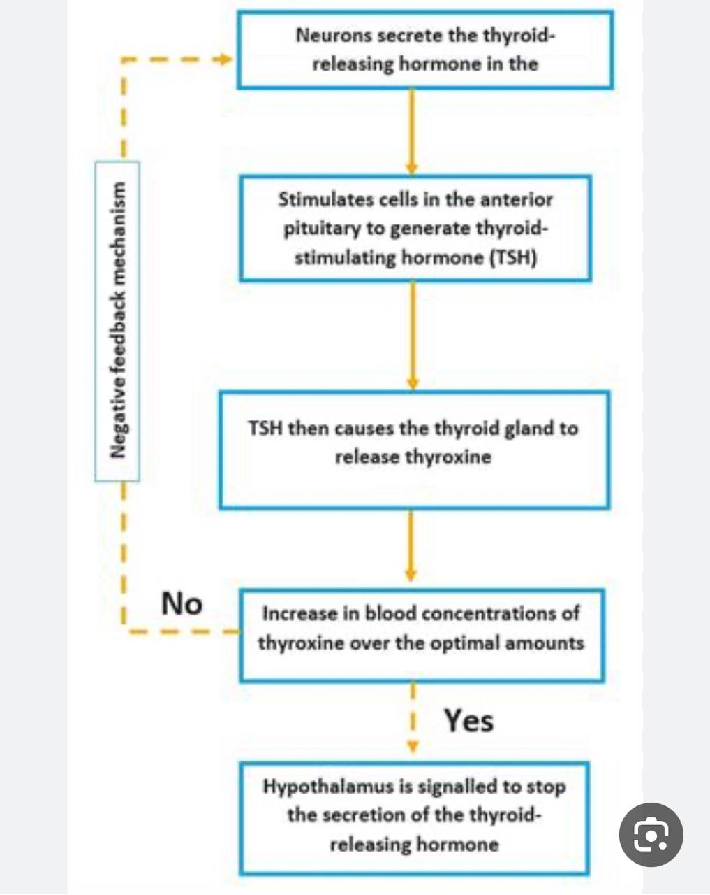

Slide 20
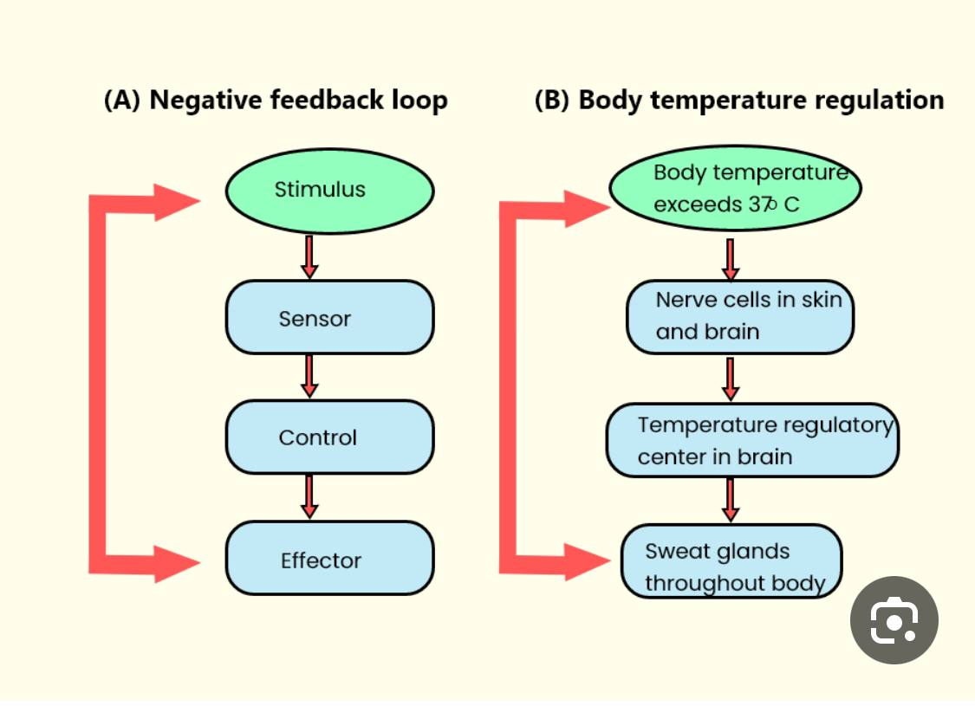

Slide 21
POSITIVE FEEDBACK
Positive feedback is the one to which the system reacts
in such a way as to increase the intensity of the change
in the same direction. Positive feedback is less common
than the negative feedback. However, it has its own
significance particularly during emergency conditions.
One of the positive feedbacks occurs during the
blood clotting. Blood clotting is necessary to arrest
bleeding during injury and it occurs in three stages.

Slide 22
The three stages are:
i. Formation of prothrombin activator
ii. Conversion of prothrombin into thrombin
iii. Conversion of fibrinogen into fibrin.
Thrombin formed in the second stage stimulates
the formation of more prothrombin activator in addition
to converting fibrinogen into fibrin . It causes
formation of more and more amount of prothrombin
activator so that the blood clotting process is accelerated
and blood loss is prevented quickly . Other
processes where positive feedback occurs are milk
ejection reflex and parturition and both the processes involve oxytocin secretion.

Slide 23
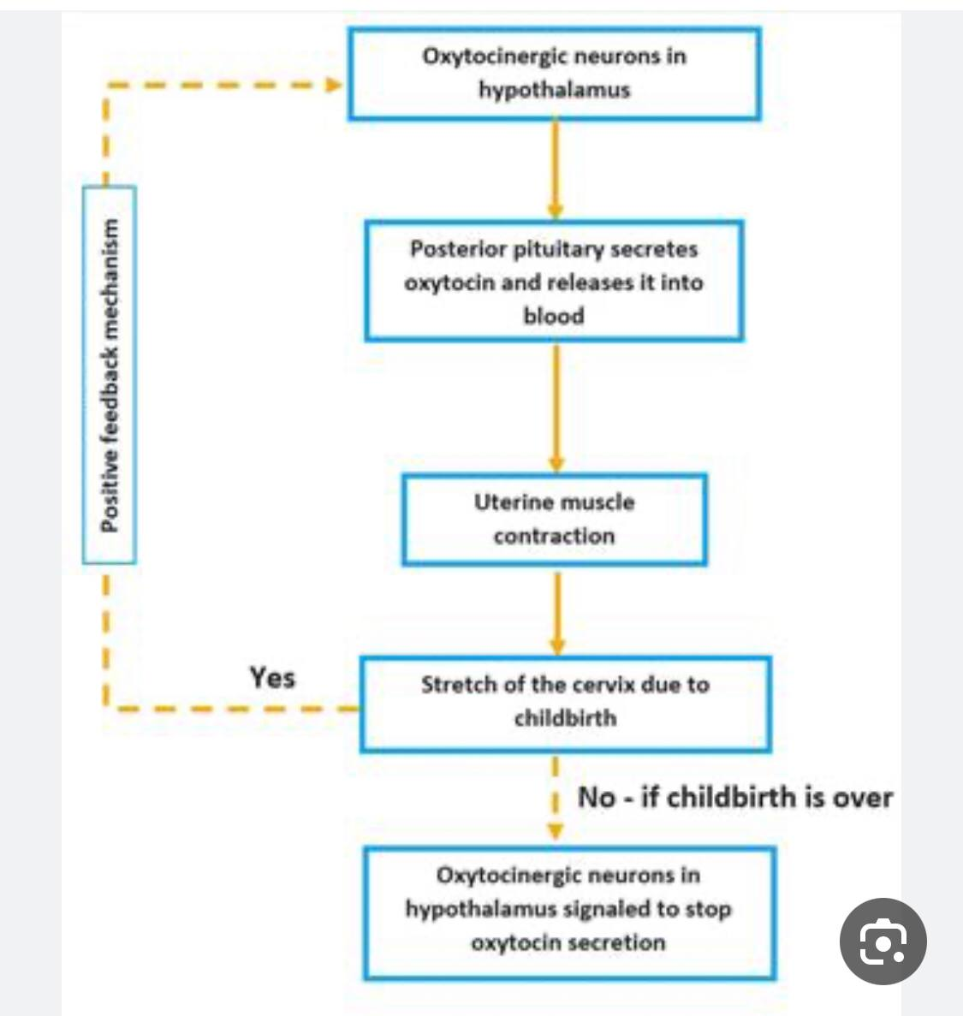

Slide 24
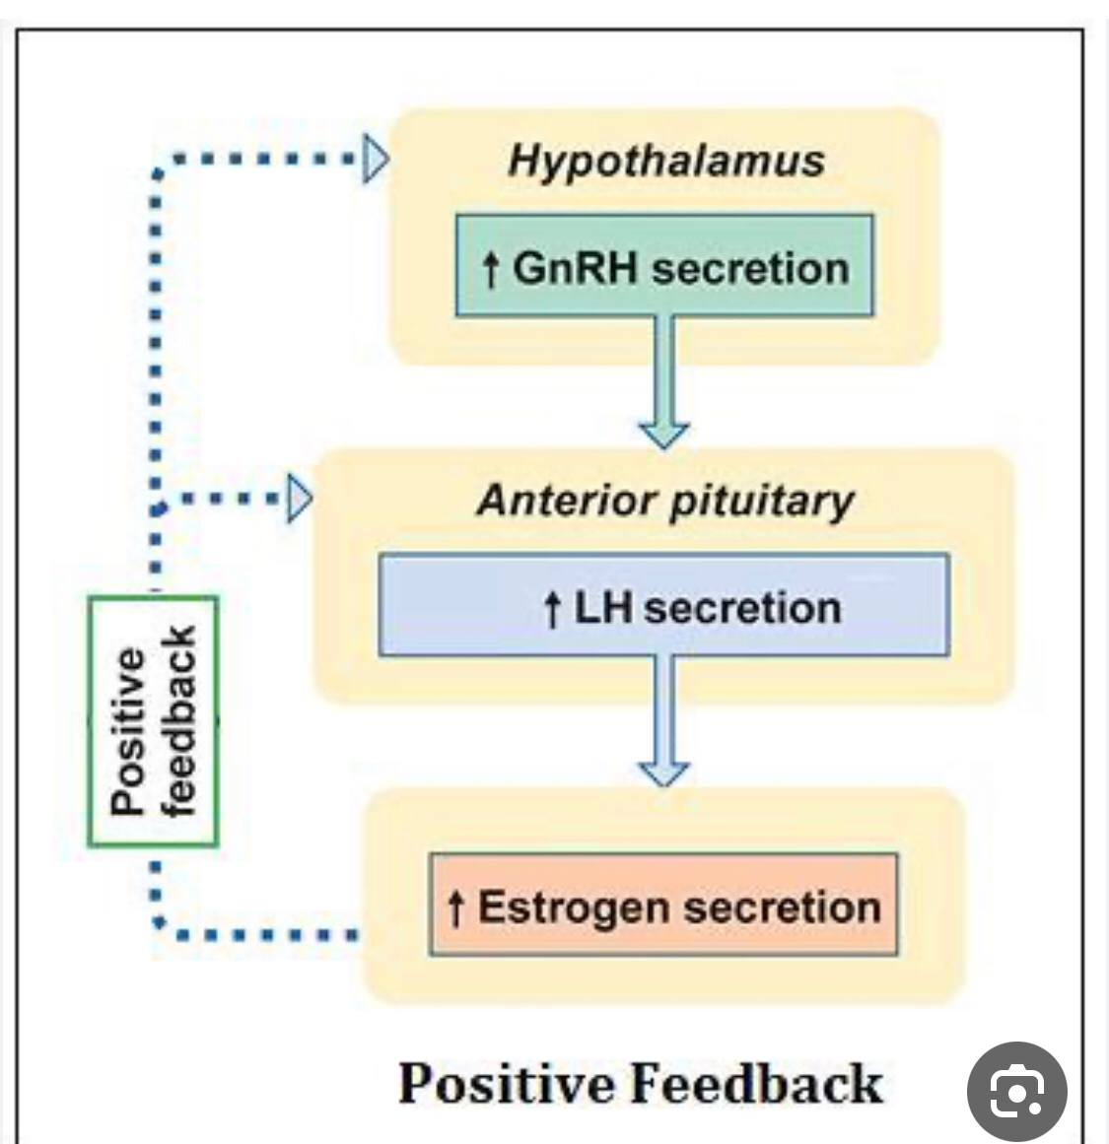

Slide 25
Role of different systems of the body in homeostasis
Almost all the systems of the human body play vital roles in the
maintenance of the internal environment. The outlines of the
contributions to different mechanisms of homeostasis made by different functional systems of the body are summarized.
1. Transport of extracellular fluid
The circulatory system plays the most vital role in the transport of
extracellular fluid (ECF) in the body. In this way, the ECF everywhere in
the body, both the plasma and interstitial fluid, is continually being
mixed, thereby maintaining almost complete homogeneity throughout
the body.

Slide 26
2. Supply of oxygen and nutrients to ECF
The nutrients and oxygen are must to provide energy for various cell
activities for the growth of the tissue. The respiratory system, digestive
system, circulatory system and the musculoskeletal system play major
roles in the supply of adequate amount of oxygen and nutrients.
Hormones play an essential role in the metabolism of nutrients and other
substances necessary for the cells.
3. Removal of metabolic end products and waste
Kidneys and other excretory organs are involved in the excretion of end
products of metabolism and other waste products. Respiratory system
plays a role in the removal of carbon dioxide from the body.

Slide 27
4. Water and electrolyte balance
in the body is maintained by a combined effort of kidneys, skin, lungs,
salivary secretion and digestive system.
5. The pH of blood and acid–base balance
are maintained by the respiratory system, kidneys, blood and the various
buffer systems in the body.
6. The temperature of the body
is maintained affirmably by a combined effort of the skin, cardiovascular
system, respiratory system, digestive system, excretory system, skeletal
muscle system and the nervous system.
7. Regulation of body functions
is very important for homeostasis. The nervous system and the hormonal
system of regulation play key roles. The autonomic nervous system
regulates all the vegetative functions of the body essential for
homeostasis.

Slide 28
8. Reproduction
Reproduction is not considered a homeostatic function. However, it does
help to maintain static conditions by generating new beings to take the
place of those that are dying. This perhaps sounds like a permissive
usage of the term homeostasis, but it does illustrate that, essentially all
body structures are so organized that they help to maintain the
automaticity and continuity of life.

